Slide 1
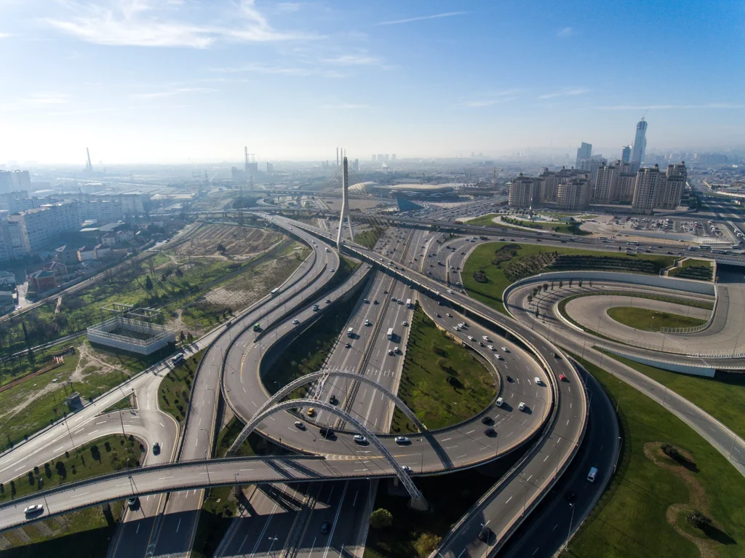

Expanding Horizons, Accelerating Growth
BSE: 541302
NSE: DHRUV
Earnings Presentation
Q1 FY26

Slide 2

Safe Harbor
This presentation has been prepared by Dhruv Consultancy Services Limited (“Company") solely for information purposes without any regard to any specific objectives, financial situation, or informational need of any particular person. This presentation may not be copied, distributed, or disseminated, directly or indirectly, in any manner. Failure to comply with this directive may result in a violation of the applicable laws in certain jurisdictions. By reviewing this presentation, you agree to be bound by the restrictions contained herein and to maintain absolute confidentiality, regarding the information disclosed in these materials.
This presentation does not constitute or form part of and should not be construed as, directly or indirectly, any offer or invitation, or inducement to sell or issue, or any solicitation of any offer to purchase or subscribe for, any securities of the Company by any person in any jurisdiction, including in India, nor shall it or any part of it or the fact of its distribution form the basis of, or be relied on in connection with, any investment decision or any contract or commitment, therefore.
This presentation contains statements that constitute forward-looking statements. These statements include descriptions regarding the intent, belief, or current expectations of the Company or its directors and officers concerning the results of operations and the company's financial condition. These statements can be recognized by the use of words such as ''expects", "plans", 'will", "estimates", "projects", or other words of similar meaning. Such forward-looking statements are not guarantees of future performance and involve risks and uncertainties and actual results may differ materially from those in such forward-looking statements as a result of various factors and assumptions that the Company believes to be reasonable in light of its operating experience in recent years. The risks and uncertainties relating to these statements include, but are not limited to, risks and uncertainties, regarding fluctuations in earnings, our ability to manage growth, and competition, our ability to manage our international operations, government policies, regulations, etc. The Company does not undertake any obligation to revise or update any forward-looking statement that may be made from time to time by or on behalf of the Company to reflect actual results, assumptions, or changes in factors affecting these statements. Given these risks, uncertainties, and other factors, viewers of this presentation are cautioned not to place undue reliance on these forward-looking statements. This presentation may contain certain currency exchange rates and the same has been provided only for the convenience of readers.
www.dhruvconsultancy.in
June 2025

Slide 3






Presentation Content
EXPERTISE IN…
1.
Financial Performance
2.
Key Highlights
HIGHWAY
BRIDGES
3.
Growth Drivers
4.
Historical Financial Overview
TUNNELS
ARCHITECTURE
5.
Financial Statement
PORTS
ENVIRONMENT
www.dhruvconsultancy.in
June 2025

Slide 4
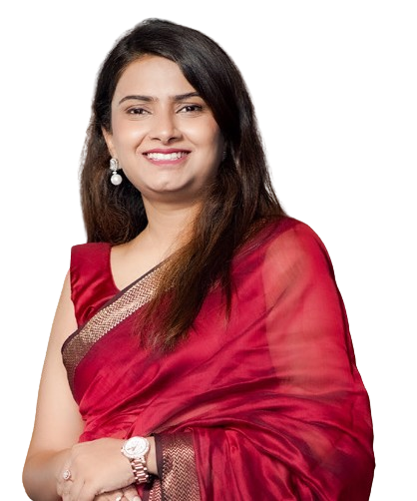
MD’s Message
“In Q1 FY26, total income rose 6.9% YoY to ₹2,140 lakh, despite a sequential dip due to year-end seasonality. EBITDA grew 26.9% YoY to ₹358 lakh, with margins improving 264 bps to 16.7%. EBIT increased 44.3% YoY to ₹251 lakh, while PBT surged 90.7% YoY to ₹210 lakh. PAT was ₹160 lakh, up 82.4% YoY, with margins expanding 309 bps to 7.5%. This robust performance was driven by higher revenue, lower employee costs, controlled other expenses, strong operating leverage, and significantly reduced finance costs.
The sector outlook remains positive, supported by the NHAI’s asset monetisation push, growing public–private partnerships, and continued government focus on national highway development. A healthy EPC and HAM project pipeline, improved toll collections, and a supportive policy framework strengthen the growth environment.
We aim to deepen our domestic presence while targeting high-margin international projects in the UAE, Dubai, and other International markets. This approach will diversify revenues, strengthen margins, and ensure steady order inflows. Through disciplined execution, prudent financial management, and a clear growth agenda, we are committed to delivering sustainable value and consistent returns for shareholders.”
Mrs. Tanvi T Auti
Managing Director
www.dhruvconsultancy.in
June 2025

Slide 5
Q1 FY26 Financial Performance
₹ in lakh
Total Income
EBITDA & Margins
PAT & Margins
YoY: ⬆ 6.9%
YoY: ⬆ 26.9%
YoY: ⬆ 82.4%
www.dhruvconsultancy.in
June 2025

Slide 6
Q1 FY26 Key Highlights
Financial Highlights:
  Revenue: Total income rose 6.9% YoY to ₹2,140 lakh, supported by sustained business momentum despite a sequential decline.
  EBITDA grew 26.9% YoY to ₹358 lakh, with margins expanding 264 bps to 16.7%, reflecting improved operational efficiency.
  EBIT jumped 44.3% YoY to ₹251 lakh, with margins improving 304 bps to 11.7%, driven by higher operating leverage, while PBT surged 90.7% YoY to ₹210 lakh, driven by higher operating profit and lower finance cost.
  PAT climbed 82.4% YoY to ₹160 lakh, with margins improving 309 bps to 7.5%, underscoring stronger bottom-line performance.
Business Highlights:
  Received LOA from IRPCL/NMDC, Jharkhand, for route alignment survey, detailed engineering survey, feasibility study report, and DPR preparation for a new railway line at Rohne Coal Block.
    Project Value: ₹ 1.94 Cr.
  Empanelled with UPEIDA, Uttar Pradesh, as Project Development & DPR Consultant for expressway projects on a “unit lane length” basis.
    Fee: ₹ 0.50 Lakh per lane KM.
  Appointed by Core Axis Company, Saudi Arabia, as Design Consultant for road projects covering surveys, drawings, section drawings, models, and road marking works.
    Project Value: ₹ 18.70 Cr.
www.dhruvconsultancy.in
June 2025

Slide 7
FY25 Business Highlights - Request For Proposal (RFP)
Company & Location | RFP Projects Description
Dhaka WASA, Bangladesh | Shortlisted to submit RFP for PMC services including design, tender documentation, and supervision for the Dhaka Water Supply Resilience Project.
National Roads Administration, Mozambique | Shortlisted to submit RFP for road design, crash evaluation, tender documentation, and supervision in Mozambique.
PWD - Manipur, India | Shortlisted for Construction Supervision Consultant services for urban road upgrades in Imphal with concrete pavements and drains.
PWD Maharashtra (ADB Funded), India | Shortlisted for Authority’s Engineer supervision services for EPC mode road packages funded by ADB.
MSIDC, Maharashtra, India | Shortlisted for Authority’s Engineer RFP for Hybrid Annuity Scheme-II; technical score was 80/100.
Dept. of Public Works, Philippines | Shortlisted to submit RFP as PMC for Bataan-Cavite Interlink Bridge under ADB and AIIB.
www.dhruvconsultancy.in
June 2025

Slide 8
FY25 Business Highlights - Request For Proposal (RFP)
Company & Location | RFP Projects Description
Roads & Highways Dept, Bangladesh | Shortlisted to submit RFP for feasibility study and design of roads and bridges in CHT region.
PWD Roads Dept, Assam, India | Shortlisted for construction supervision of 1184 bridges under ARRPB across 35 districts.
www.dhruvconsultancy.in
June 2025

Slide 9
FY25 Business Highlights – Secured Projects
Company & Location | Secured Projects Description | Project Cost
GSRDC, Gujarat | Received LOA for Independent Engineer services for 24.111 km four-lane corridor under HAM. | ₹ 5.70 Cr
NHAI, UP & Haryana | LOA for IE services for two 4-lane Aligarh–Palwal road packages on HAM Mode. | ₹ 4.74 Cr
ANE, Mozambique | Awarded LOA for consultancy on crash locations, design, tendering, and supervision. | ₹ 4.18 Cr
MSIDC, Maharashtra | LOA for Authority’s Engineer services for Hybrid Annuity Scheme-II (Group 13); 90-month contract. | ₹ 23.46 Cr
NHAI, Maharashtra | Approved variation proposal for additional EPC works (ROBs, VUPs, flyovers). | ₹ 2.20 Cr
MoRTH, Karnataka | LOA for DPR consultancy on NH-766C and NH-369E. | ₹ 2.31 Cr
www.dhruvconsultancy.in
June 2025

Slide 10
FY25 Business Highlights – Secured Projects
Company & Location | Secured Projects Description | Project Cost
HPRIDCL, Himachal Pradesh | Notice to Proceed for 160m cantilever bridge construction supervision. | ₹ 0.44 Cr
MMRDA, Maharashtra | LOA for PMC at 6 Mumbai Metro Line 5 stations. | ₹ 1.35 Cr
NHAI, Uttar Pradesh | LOA for Authority’s Engineer for 6-lane greenfield bypasses around Kanpur. | ₹ 7.85 Cr
GSRDC, Gujarat | Received LOA for Independent Engineer services for 24.111 km four-lane corridor under HAM. | ₹ 5.70 Cr
NHAI, UP & Haryana | LOA for IE services for two 4-lane Aligarh–Palwal road packages on HAM Mode. | ₹ 4.74 Cr
ANE, Mozambique | Awarded LOA for consultancy on crash locations, design, tendering, and supervision. | ₹ 4.18 Cr
www.dhruvconsultancy.in
June 2025

Slide 11
FY25 Business Highlights – Secured Projects
Company & Location | Secured Projects Description | Project Cost
MSIDC, Maharashtra | LOA for Authority’s Engineer services for Hybrid Annuity Scheme-II (Group 13); 90-month contract. | ₹ 23.46 Cr
NHAI, Maharashtra | Approved variation proposal for additional EPC works (ROBs, VUPs, flyovers). | ₹ 2.20 Cr
MoRTH, Karnataka | LOA for DPR consultancy on NH-766C and NH-369E. | ₹ 2.31 Cr
HPRIDCL, Himachal Pradesh | Notice to Proceed for 160m cantilever bridge construction supervision. | ₹ 0.44 Cr
MMRDA, Maharashtra | LOA for PMC at 6 Mumbai Metro Line 5 stations. | ₹ 1.35 Cr
NHAI, Uttar Pradesh | LOA for Authority’s Engineer for 6-lane greenfield bypasses around Kanpur. | ₹ 7.85 Cr
www.dhruvconsultancy.in
June 2025

Slide 12
FY25 Business Highlights – Secured Projects
Company & Location | Secured Projects Description | Project Cost
HCC, Maharashtra | Contract for design proof checking for 2-lane bridge across Agardanda Creek on Revas-Redi Coastal Highway. | ₹ 1.09 Cr
Indore Municipal Corp, Madhya Pradesh | LOA for PMC for Indore Master Plan road works. | ₹ 1.25 Cr
NHAI, West Bengal | LOA for IE services on NH-116A Bowaichandi–Guskara section. | ₹ 4.68 Cr
West Central Railway, India | LOA for General Consultant for rail infra projects; largest awarded to company in rail sector. | ₹ 11.05 Cr
NHAI, Madhya Pradesh | LOA for supervision during O&M on NH-46 Obedullganj–Itarsi section. | ₹ 6.37 Cr
NHAI, West Bengal | LOA for IE services for NH-116A Mayurakshi Bridge–Moregram section. | ₹ 4.50 Cr
www.dhruvconsultancy.in
June 2025

Slide 13

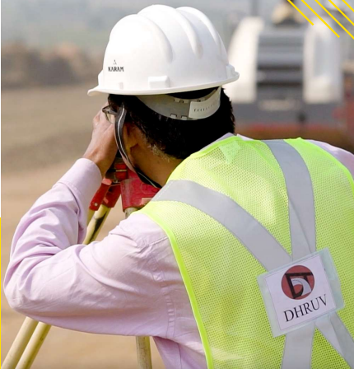

Company Overview
400+ EMPLOYEES
25+
HAPPY CLIENTS
200+ COMPLETED PROJECTS
Founded
Services
Diversification
Dhruv Consultancy Services Ltd.
ISO 9001:2015 Certified | Established 2003
One of India’s fastest-growing infrastructure consultancies, delivering strategic expertise and engineering solutions to global clients.
End-to-End Infrastructure Solutions
A multidisciplinary infrastructure consulting firm delivering integrated services in design, engineering, procurement, construction, and project management.
We specialize in detailed project reports, feasibility studies, and operations & maintenance assignments. Backed by strong technical acumen and a solid execution record, we’re a trusted partner for large-scale infrastructure projects across India.
Expanding Beyond Government
Traditionally serving government clients like NHAI and MoRTH, Dhruv is now expanding into high-margin private sectors. Focus areas include lenders’ engineering, wayside amenities, and global design outsourcing—to diversify revenue and reduce public-sector dependency.
www.dhruvconsultancy.in
June 2025

Slide 14
Journey So far
Incorporation as Dhruv Consultancy Services Private Limited.
First PMC Project
Bhiwandi - Kalyan Shilphata.
First Expressway Project:
Missing Link of Mumbai - Pune
Expressway.
First NHAI Project: Khed - Sinnar Highway.
Entry in Ports Sector: Jalna & Wardha Dry Port .
Name changed to Dhruv Consultancy Services Limited. Successful Listing on BSE-SME on May 10.
2003
2006
2011
2014
2016
2018
Incorporation of Subsidiary in UK:
Dhruv International Private Limited
Entry in Railway Sector:
Gati Shakti Unit, Salem Division
Entry in Metro Sector Line 2A & 7 of Mumbai Metro
Listing on NSE. Migration to Main Board of BSE & NSE on November 25
2024
2023
2022
2021
www.dhruvconsultancy.in
June 2025

Slide 15
Historical Financial Performance
₹ in lakh
Total Income
EBITDA
PAT
CAGR: ⬆ 14.7%
CAGR: ⬆ 14.0%
CAGR: ⬆ 9.3%
www.dhruvconsultancy.in
June 2025

Slide 16
Historical Financial Performance
Debt-to-Equity Ratio
(x)
Debt Service Coverage Ratio (x)
Return On Equity
(%)
Return On Capital Employed (%)
www.dhruvconsultancy.in
June 2025

Slide 17
Growth Drivers
1
Diversification of Services:
Current Services:
    Design and Engineering: Feasibility Studies, Detailed Designing, Traffic & Transportation Studies, Environmental Impact Assessment, Economic/Financial Analysis, Proof Checking
    Project Management: Construction Supervision, Contract Administration, Operation & Maintenance
    Techno-Advisory: Pre Bid Engineering, Asset Management, Safety Audits, Lenders Engineering.
Future Areas: Sustainable infrastructure, digital transformation and technology integration, smart cities, transportation solutions, and regulatory and policy consulting.
Goal: Enhance client satisfaction and competitive edge by expanding service offerings.
2
Technology Adoption:
Initiatives: Embrace digital tools, data analytics, and smart technologies.
Aim: Increase efficiency, accuracy, and sustainability of services by integrating advanced technology.
www.dhruvconsultancy.in
June 2025

Slide 18
Growth Drivers
3
Vertical Integration:
Comprehensive Service Offering: The company has developed strong internal capabilities in private equipment leasing, project supervision, and Detailed Project Reports (DPR). By integrating Operations & Maintenance (O&M) and equipment leasing, it delivers end-to-end solutions from planning to execution.
Strategic Contracts: A focus on high-quality proposals ensures strong client relationships and competitiveness. The company has secured long-term contracts, including traffic surveys for NHAI and 24/7 government projects. Large-scale agreements with PSUs and NHAI further strengthen its reputation for delivering complex infrastructure projects.
Diversification: Expanding into Traffic Surveys, Private Equipment Leasing, Design Engineering, and Safety Consulting, the company has established a strong presence in Railways, Airports, and Road Infrastructure, ensuring sustainable growth and long-term success.in upcoming period.
4
Strategic Partnerships:
Target Partners: Technology providers, leading consultancy firms, and government agencies, both domestically and internationally.
Strategy: Forge alliances to access new markets, expand capabilities, and deliver comprehensive solutions.
Goal: Unlock new growth avenues and enhance service delivery through strategic collaborations.
www.dhruvconsultancy.in
June 2025

Slide 19
Growth Drivers
5
Geographic Expansion:
Focus Regions: Sub-Saharan Africa, South East Asia, Gulf, Central & South Asia, in addition to India.
Current Progress: In FY25, we submitted 54 EOIs across 14 countries, with 5 shortlisted in 3 countries and 39 results pending. Additionally, 9 FTP were submitted in 6 countries, with 1 result awaited. So far, 3 projects have been awarded in Mozambique, Ghana, and Imphal City (India), marking early success.
Objective: Establish a global presence and capitalise on growth opportunities in emerging markets.
6
Infrastructure Growth Opportunities:
Transportation & Expressway Expansion: The company is actively involved in expressway and highway projects across 20+ states, conducting high-accuracy traffic surveys (95-98%). It is also engaged in 2-lane and 3-lane expressway developments, focusing on signal and safety engineering, along with BOT/MSRDC projects under value engineering.
Strategic Partnerships & Outsourcing: Revenue growth is driven by international collaborations in engineering and DPR services. Expanding consultancy and outsourcing services further strengthens the company’s global reach. Additionally, participation in 12 way-side amenities projects in Maharashtra and Rajasthan is set to enhance profitability.
Railway & Aviation Infrastructure: Providing General Consultancy (GC) for metro projects in two key corridors reinforces its role in railway infrastructure. The company is also increasing its presence in airport projects, including the Navi Mumbai Airport vertical.
www.dhruvconsultancy.in
June 2025

Slide 20
Consolidated Profit & Loss Statement
Parameters (₹ in lakh) | Quarterly | Q1FY24 | QoQ |  | Q2FY23 |  | Yearly
 | Q1 FY26 | Q4 FY25 | QoQ | Q1 FY25 | YoY |  | FY25
Total Income | 2,140.1 | 2,802.9 | (23.6%) | 2,001.5 | 6.9% |  | 10,352.1
Employee Cost | 539.2 | 557.9 |  | 574.8 |  |  | 2,279.8
Other Expenses | 1,243.1 | 1,754.3 |  | 1,144.9 |  |  | 6,494.5
EBIDTA | 357.8 | 490.8 | (27.1%) | 281.9 | 26.9% |  | 1,577.8
EBIDTA Margin | 16.7% | 17.5% | (79 bps) | 14.1% | 264 bps |  | 15.2%
Depreciation | 106.7 | 118.9 |  | 107.9 |  |  | 453.6
EBIT | 251.1 | 371.8 | (32.5%) | 174.0 | 44.3% |  | 1,124.2
EBIT Margin | 11.7% | 13.3% | (153 bps) | 8.7% | 304 bps |  | 10.9%
Finance Cost | 41.4 | 48.9 |  | 64.0 |  |  | 205.2
PBT | 209.8 | 323.0 | (35.1%) | 110.0 | 90.7% |  | 919.0
Tax | 50.1 | 123.7 |  | 22.5 |  |  | 228.7
PAT | 159.7 | 199.2 | (19.9%) | 87.5 | 82.4% |  | 690.3
PAT Margin | 7.5% | 7.1% | 35 bps | 4.4% | 309 bps |  | 6.7%
www.dhruvconsultancy.in
June 2025

Slide 21
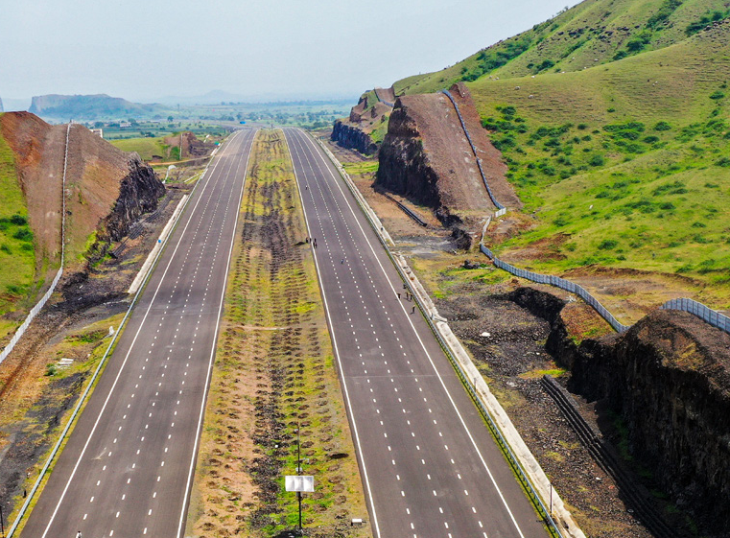

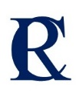
THANK YOU!
Dhruv Consultancy Services Limited:
Mr. Paresh Suhas Dange
Company Secretary & Compliance Officer
T: 022 2757 0710
E: cs@dhruvconsultancy.in
W: www.dhruvconsultancy.in
Investor Relations Advisor:
Mr. Ritesh Shashiprakash Singh
Investor Relations Consultant, Rik Capital
M: 083293 85762
E: ritesh.singh@rikcapital.in
W: www.rikcapital.in

